Slide 1
Homework Help
Richard Jones MS, LBA, BCBA

Slide 2
Introduction
Board Certified Behavior Analyst
NYS Licensed Behavior Analyst
Working with kids with behavior problems since 1998
Provide Consultation and Parent Training to Great Neck students and families since 2008
Director of Long Island ABA

Slide 3
“I remember our childhood days
when life was easy
and math problems hard.
Mom would help us with our homework
and dad was not at home
but at work.
After our chores,
we’d go to the old fort museum
with clips in our hair and pure joy in our hearts.
You, sister, wore the bangles
that
you, brother, got as a prize from the Dentist.
“Why the bangles?” the Dentist asked,
surprised,
for boys picked the stickers of cars instead.
“They’re for my sisters,” you said.
Mom would treat us to a bottle of Coke,
a few sips each. Then,
we’d buy the sweet smelling bread
from the same white van
and hand-in-hand,
we’d walk to our small flat
above the restaurant.
I remember our childhood days.
Do you remember them too?”
― Kamand Kojouri

Slide 4
Pre-homework skills
If you can't put away your toys, you might not be ready for homework

Slide 5
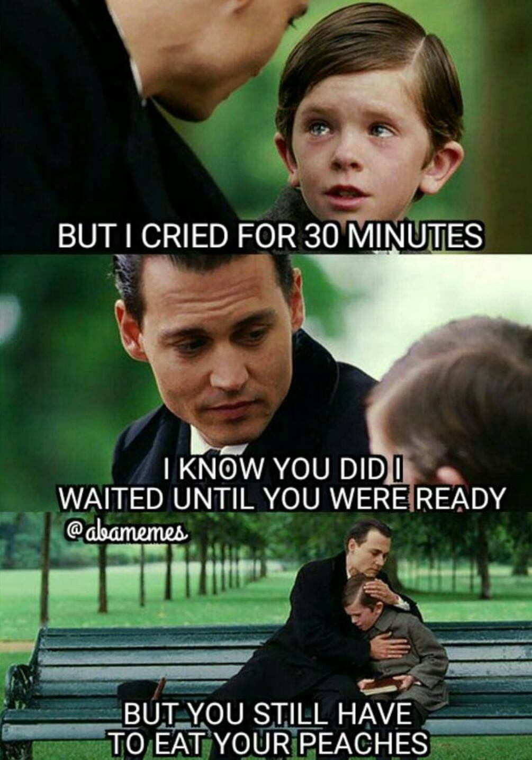
Arrange the Environment
Remove distractions
Have materials ready
Have work or activity you can do while they work
Control your reinforcers

Slide 6
Create a Routine
Morning Routines, Bedtime Routines, Mealtime Routines, Riding in the car Routines, Friends over Routines

Slide 7
Premack Principle
Make them WANT to do it, not just make them do it
Determine what privileges are valuable to them and make them ONLY available after homework is complete
Tell them the expectations one time, then do not repeat yourself. No negotiating!

Slide 8
Behavioral Momentum
Make sure your child can comply with a wide variety of easy demands before trying to place a large demand
Program in frequent opportunities for your child to practice complying with demands
Easy, easy, hard, reward!

Slide 9
Errorless Teaching
If your child is struggling, model how to do the work
Use phrases to explain each step and repeat the phrase every time you do the step (they will hear your voice when they are doing it without you)
Fade your supports slowly, and if they are struggling, give more examples
Have them complete the first step after you model, or have them do the last step. Increase expectations over time.
Test for understanding. If you showed them how to do 5 math problems and they did 3 with your help, have them try 1 on their own while you watch.

Slide 10
Take Data
Record how long homework took, and if they did it with no resistance or help.
Post the data in the house where it can be seen and praise frequently for their work (even if there were small problems). Build up the good, and it will grow.
Delayed praise when other family members come home.
Provide rewards for good trends (daily and weekly)

Slide 11
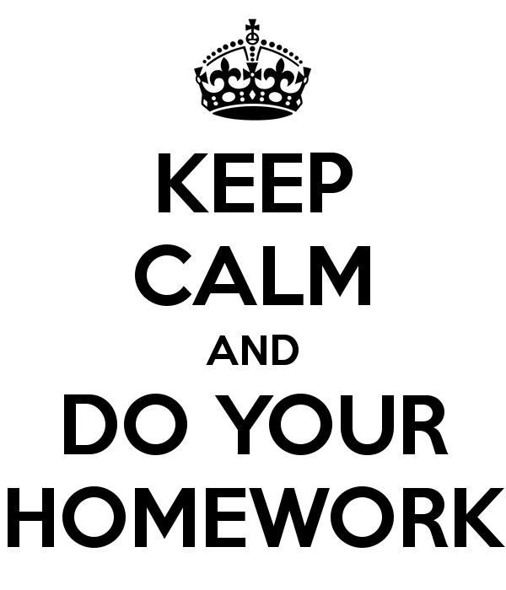

Slide 12
Make it a fun time and it will no longer be work.

